Slide 1
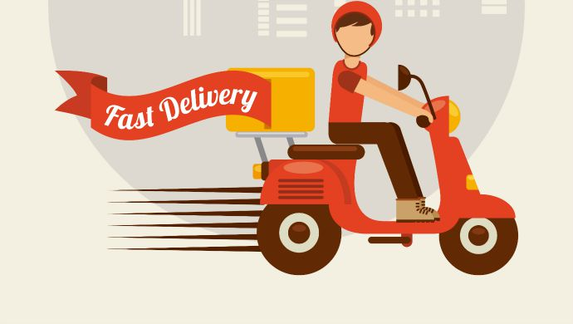
Food-Delivery Web Application
Li Chen, Jianhui Lu, Weiran Yuan
ITWS_6700_Software Development
12/11/2017

Slide 2
Brief Introduction
Our group chose to build a web application of delivery system. It would be useful if people want to order things online.
The system connects Customer/Restaurant users with Servers and connects Server with Database.
The system aims to provide connections between restaurants and customers
Customer can easily order food
Restaurants can have more business opportunities

Slide 3
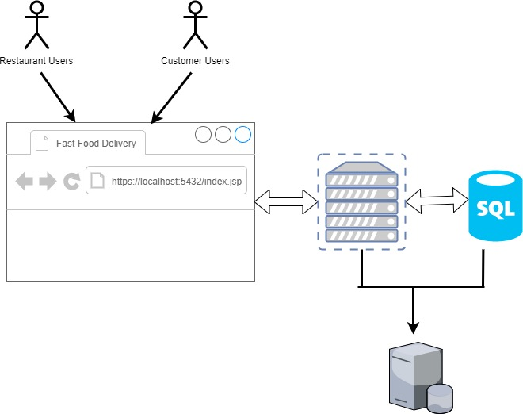
Three-Tiers Organization
Restaurant/Customer Users < -- > Browser
Browser < -- > Virtual Server (Tomcat)
Virtual Server < -- > Database
Server & Database On the same Teminal (Our Laptop)

Slide 4



Project Management Tools & Version Control

Slide 5
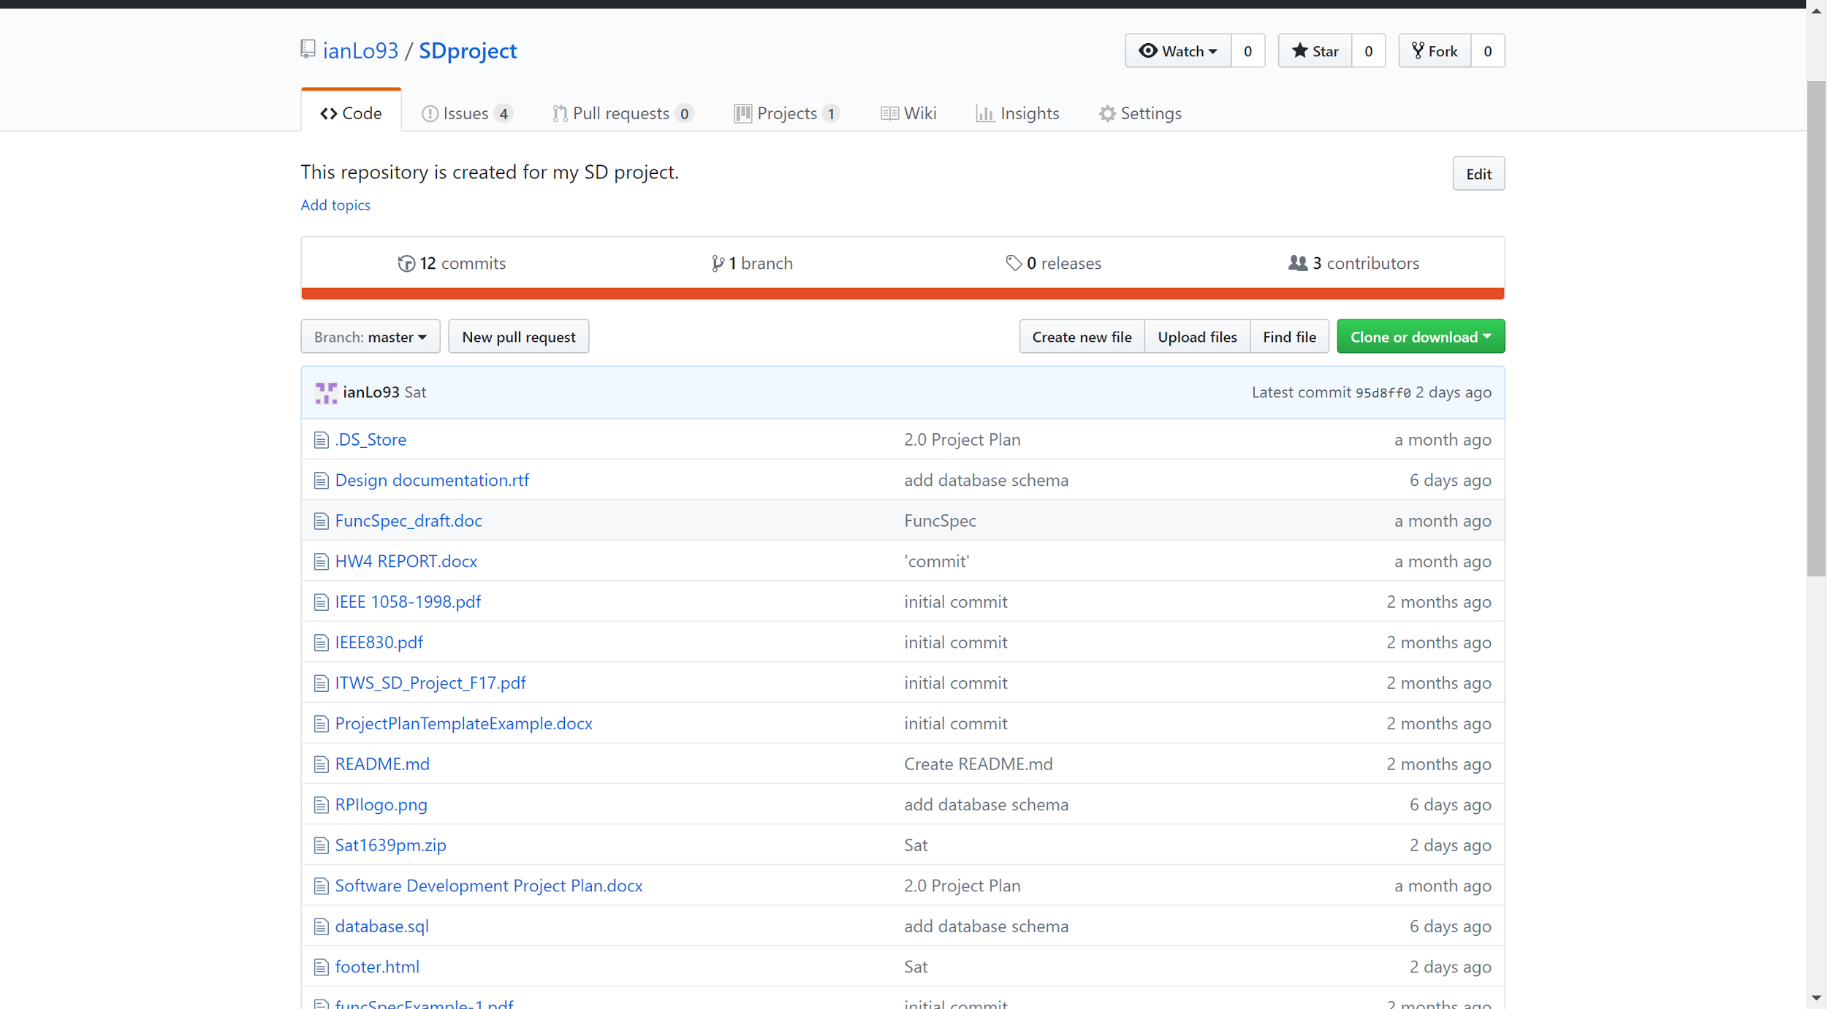
Version Control

Slide 6
Feature Driven Management
App Analysis
Specify Features of the Application
Design Interface of the Web Application
Build app by Features
Promote Features

Slide 7
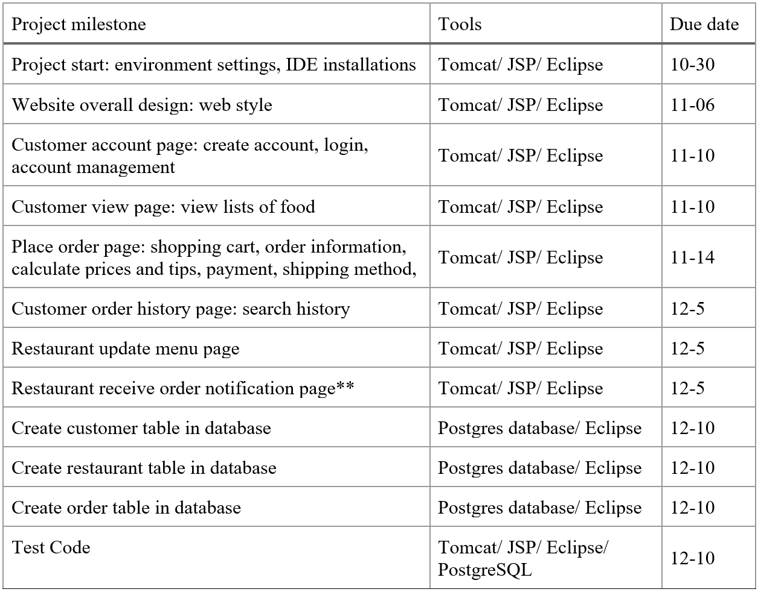
Project Schedule

Slide 8
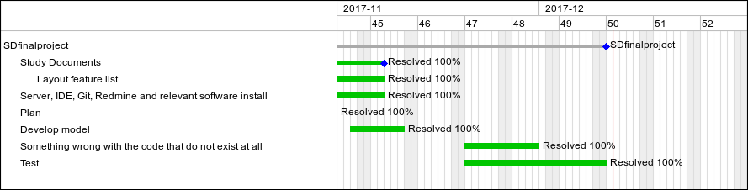
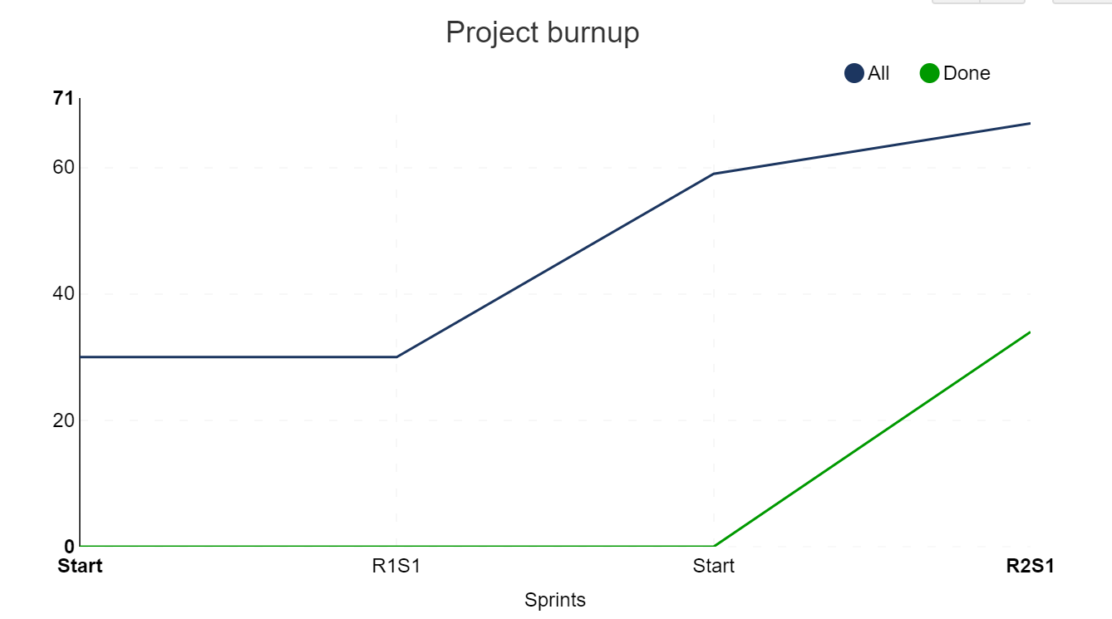
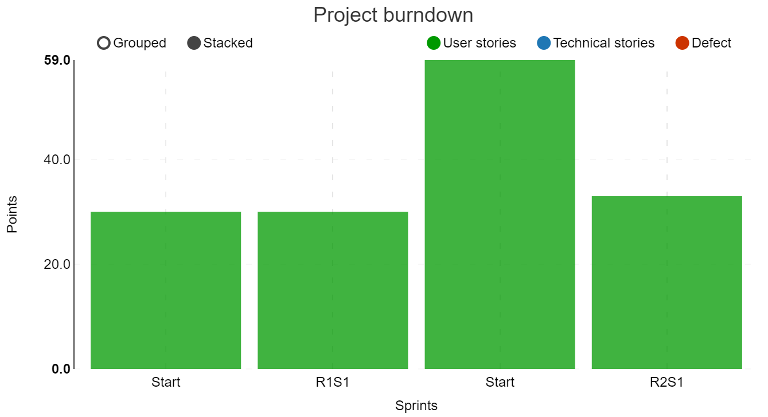
Charts

Slide 9


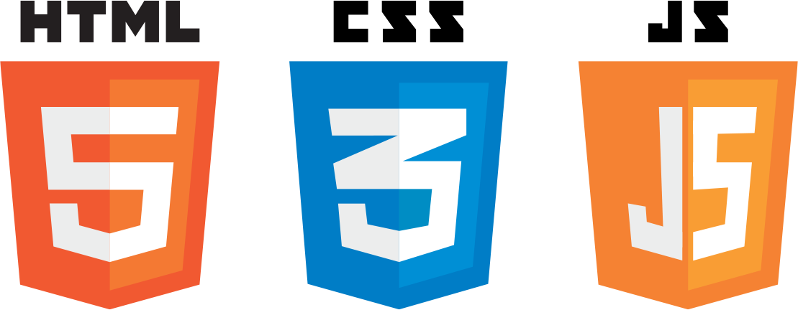



Language and IDE

Slide 10
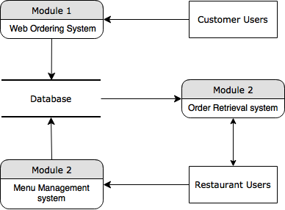
How does the app functions?

Slide 11
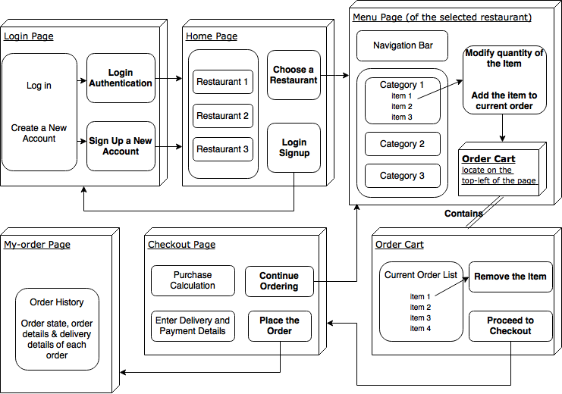

Slide 12
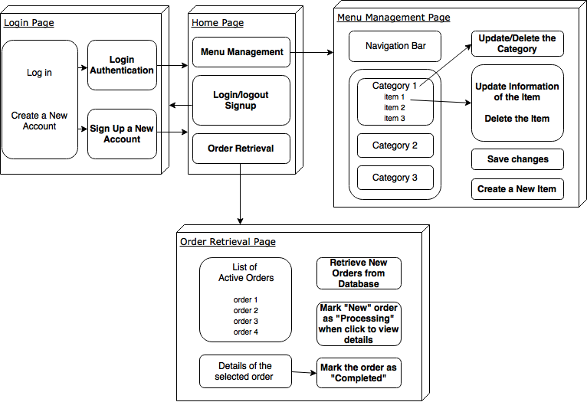

Slide 13
Design Patterns
State Pattern: Order state changes
Observer Pattern: Customer and Restaurant state change accordingly
Adapter Pattern: Order needs adapter to access items

Slide 14
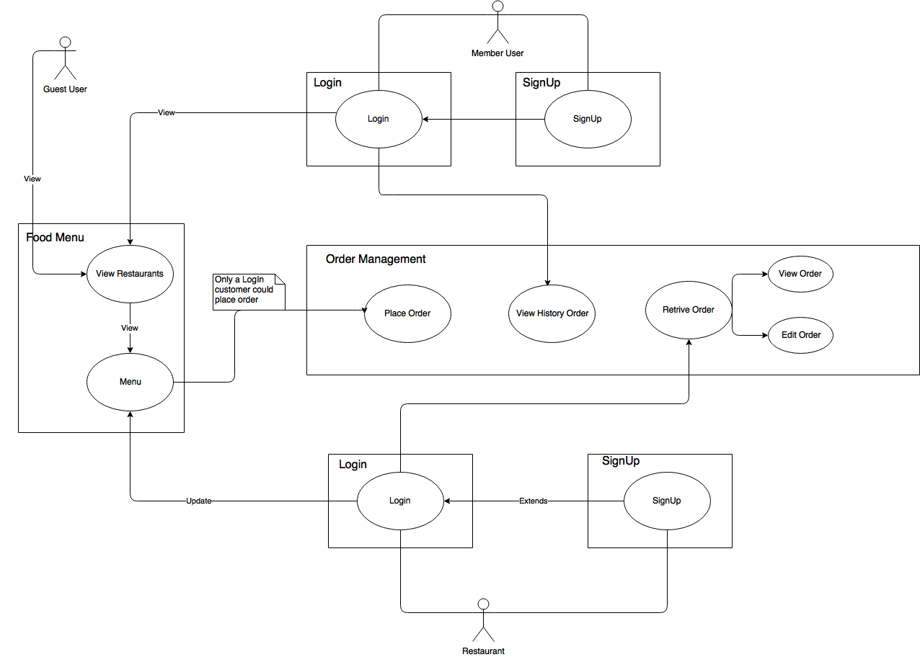
Use Case Diagram

Slide 15
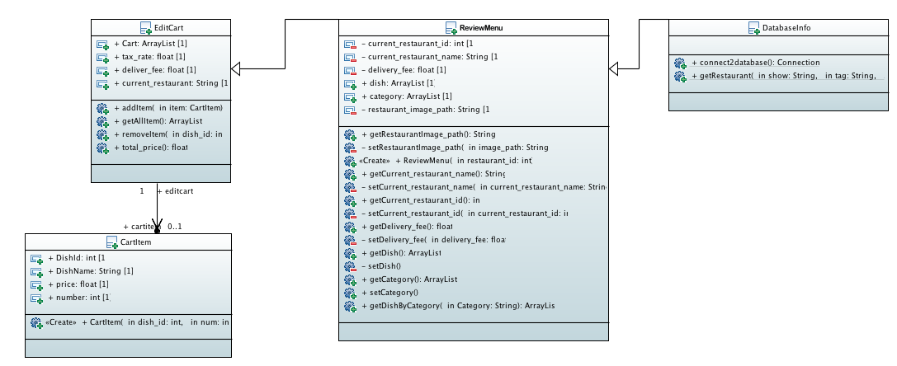
Class Diagram -ViewMenu

Slide 16
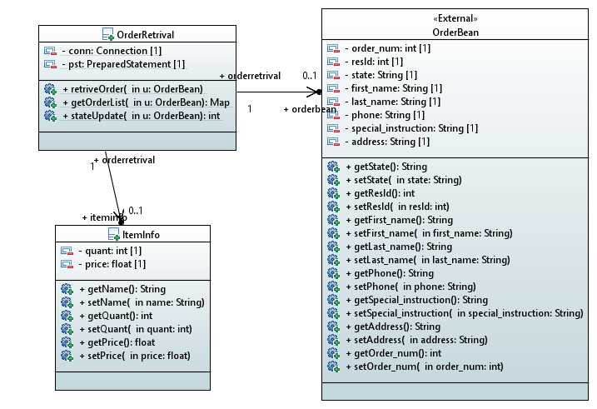
Class Diagram -Order Retrieve

Slide 17
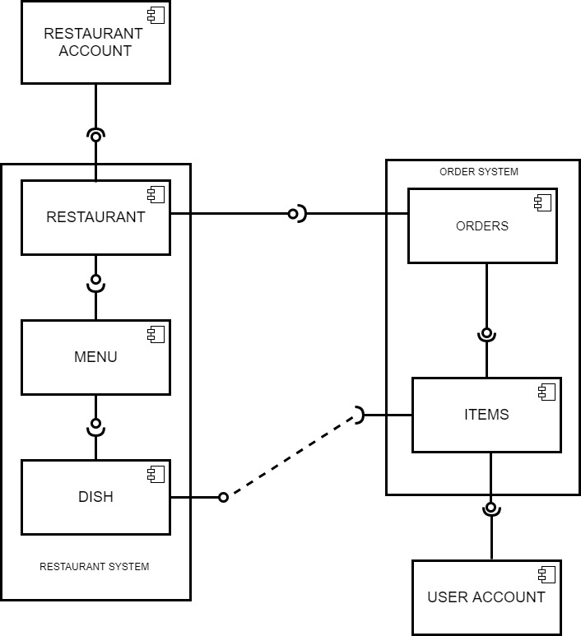
Component diagram

Slide 18
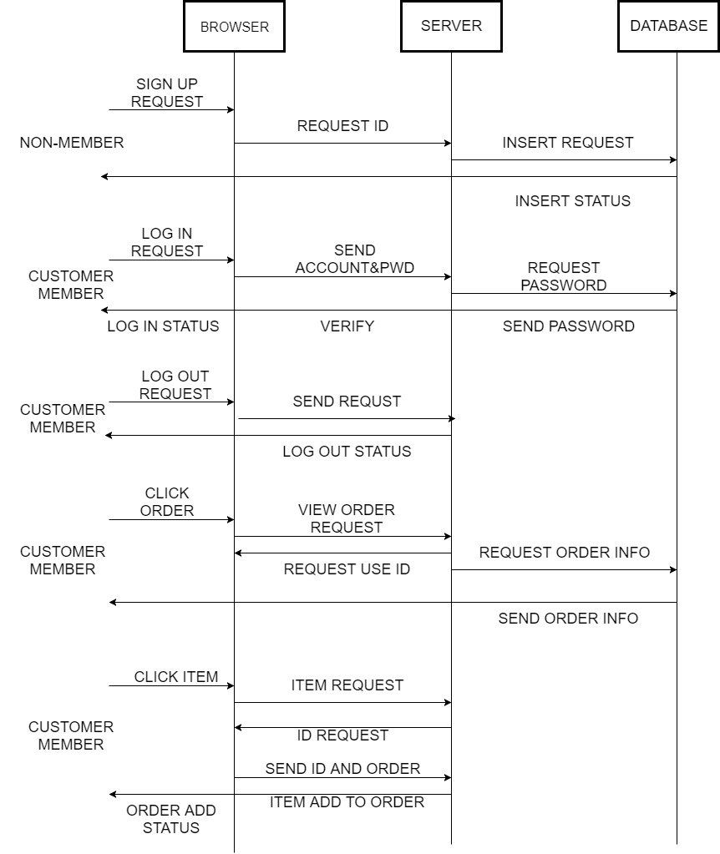
SEQUENCE DIAGRAM
--CUSTOMER

Slide 19
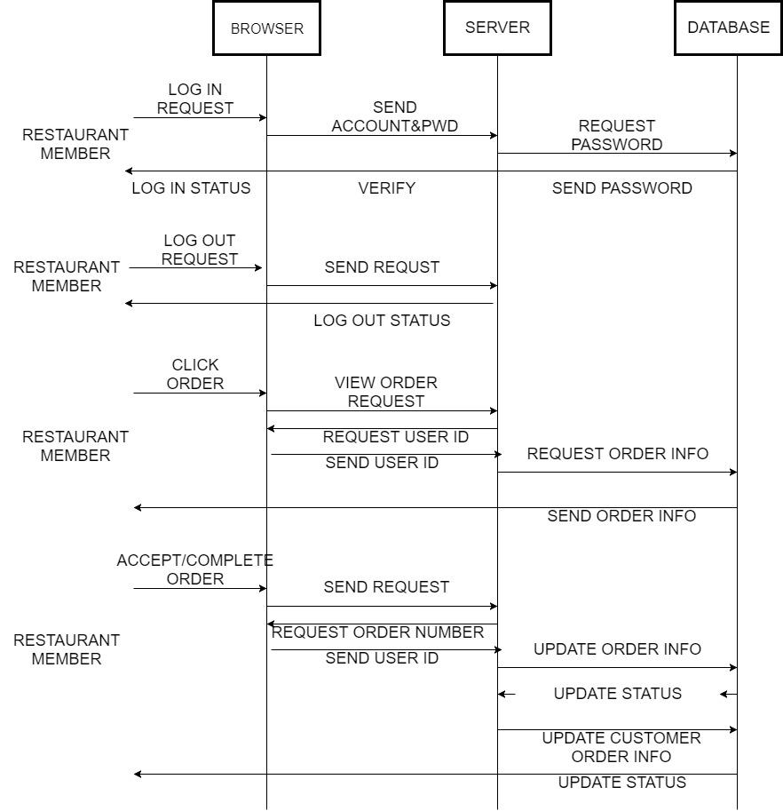
SEQUENCE DIAGRAM
--RESTAURANT

Slide 20
Thank you!
Any questions?

